Slide 1

Medical Recommendation Chatbot

Slide 2


IIS (Deemed to be) University
Submitted to:
Dr. Amita Sharma
Dr. Astha Pareek
Assistant professor, (SG)
Department of CS/IT
Submitted by :
Shraddha Laddha
Enroll no-IISU/2023/ADM/36206
B.SC(H) in Data Analytics and AI

Slide 3

Table of Contents
Problem Statement
Objectives
Methodology
System Workflow
Figures and Screenshots
Future Enhancements
References
Conclusion

Slide 4

Problem Statement
Many people struggle to identify suitable medicines for common symptoms like cough, fever, or headache. Relying on unverified sources can lead to misinformation and health risks. Access to doctors is often delayed or unavailable in non-emergency situations. There is a need for a basic tool to suggest over-the-counter remedies and provide disease awareness. This project builds a chatbot that interacts with users to recommend initial medicines and guide them based on symptoms

Slide 5
Objectives
To develop a chatbot that helps users identify suitable medicines based on their symptoms.
To offer basic healthcare support for common illnesses.
To increase public awareness and reduce reliance on unverified sources.
To provide quick assistance when professional medical help is not immediately accessible.

Slide 6

Methodolodgy
Extract keywords
Match with symptoms
Recommend medicines
Fallback if no match

Slide 7

System Workflow
Page Load:
Interface with gradient background, header, chat section, and user input form.
User Input:
User types a message and submits (via button or Enter).
Input is sanitized and displayed in the chat.
Bot Response Generation:
Dataset Check: Matches input with predefined diseases and medicines.
Symptom Extraction: Identifies symptoms (e.g., headache, fever).
OTC Recommendations: Suggests over-the-counter medicines based on symptoms.
Fallback: Provides generic response (greetings, help).
Display Bot Response:
Bot response is added to the chat history, displayed in the chat section.
Input Reset:
Input field is cleared and focus is returned for next input.
Styling & UI:
Mobile-responsive design with styled input field and buttons.
User and bot messages are styled differently (left and right).

Slide 8

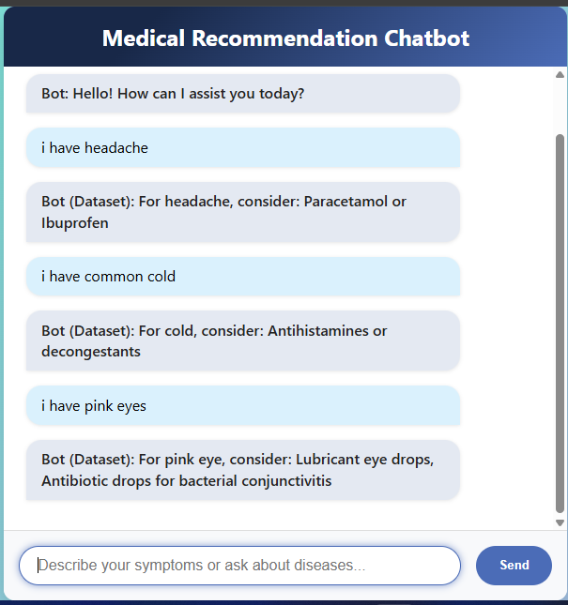
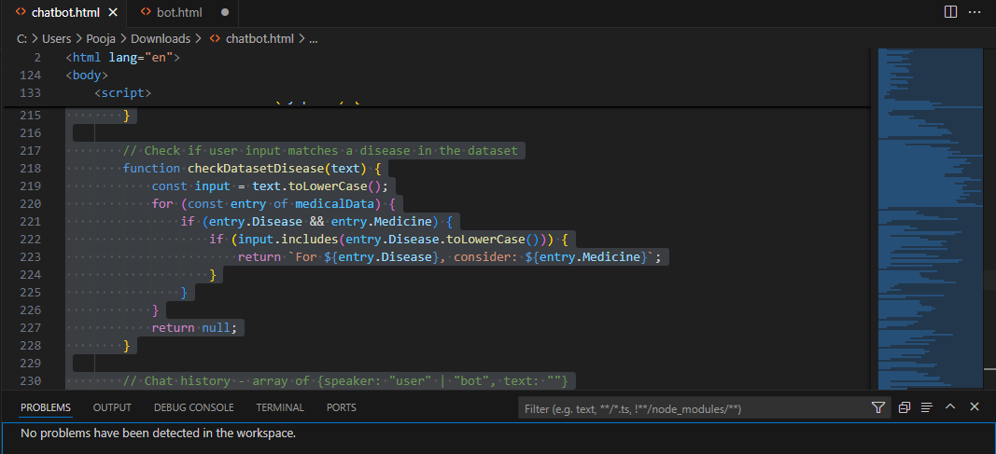
Figures and screenshots
Fig:2
Fig:2 Code (VS Code)
Fig:1 Web Interface

Slide 9

Future Enhancements
Advanced NLP Integration: Enhance understanding with AI models (e.g., GPT-4).
User Profile & History: Personalize recommendations based on user data.
Voice Input: Enable voice interaction for better accessibility.
Doctor Consultation: Option for live doctor consultations.
Expanded Dataset: Include more symptoms, diseases, and treatments.
Multi-Language Support: Offer global accessibility in various languages.
AI-powered Predictions: Predict health issues based on trends.
Medication Reminders: Set up medication tracking and alerts.
Health Device Integration: Sync with wearables for real-time monitoring.
Emergency Alerts: Provide urgent health condition alerts.

Slide 10















Conclusion
The Medical Recommendation Chatbot serves as a valuable tool in providing immediate, accurate, and accessible health guidance based on user-reported symptoms. By leveraging a basic dataset, the chatbot offers personalized recommendations and suggests over-the-counter medications, helping users manage minor health issues effectively. Future enhancements such as integrating advanced AI models, expanding the dataset, and offering real-time doctor consultations will further improve the chatbot’s capabilities, making it an even more comprehensive and reliable health assistant. This project demonstrates the potential of AI-driven solutions in transforming healthcare accessibility and efficiency.

Slide 11
References
https://www.kaggle.com/datasets/joymarhew/medical-reccomadation-dataset
W3School
Chatbot tutorials

Slide 12
Thank you!

